Slide 1
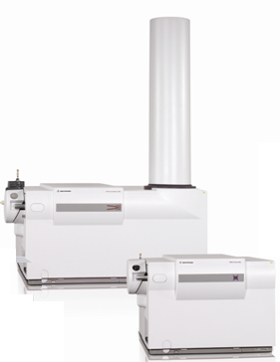
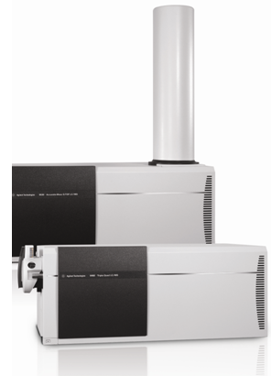
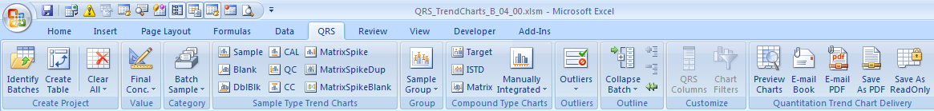
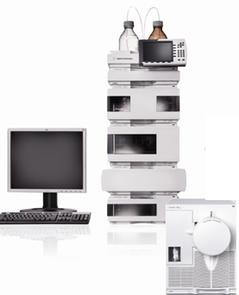
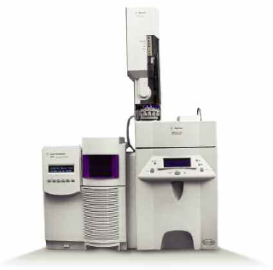
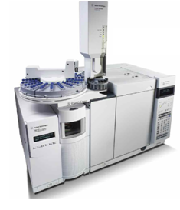
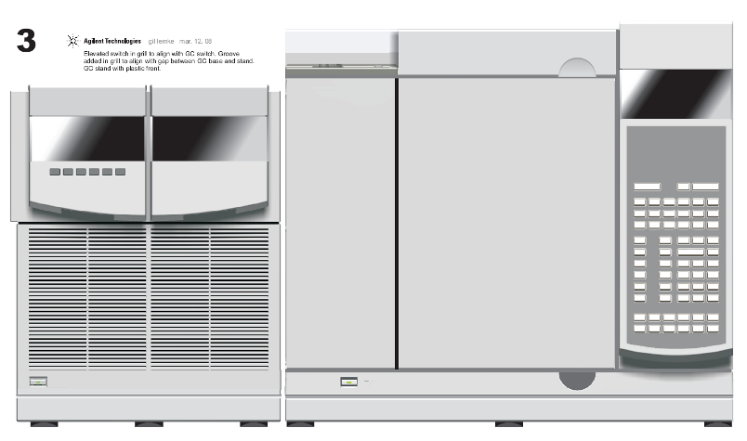
Excel-based Quantitation Report System (QRS) Trending
  Extension of MassHunter integrated Excel-based reporting
Notes:
1
There is a portfolio of Agilent GC/MS products:
Start with the 6850GC/5975 VL diffusion pump system. Lowest priced Agilent GC/MS solution. Ideal for dedicated headspace GC/MS applications.
Smallest lab bench footprint.
5975C/7890A is the world’s best selling GC/MS system. Proven performance, superior productivity: Synchronous SIM/SCAN, EI,CI,NCI; capillary flow for backflush and detector splitting; Deconvolution reporting software, new triple axis detector,retention time locking, trace ion detection technology turbomolecular pumping to allow higher GC column flows….
Now the new Agilent 7000A Triple Quad GC/MS Systems. Power of MS/MS to allow quantitation of trace target compounds in complex matrices.
This new system is based on the 5975C architecture.

Slide 2
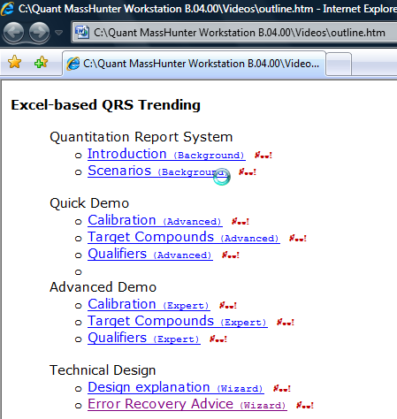
Excel-based Quantitation Report System (QRS) Videos
Videos on shipping Quant DVD
Notes:
2
There is a portfolio of Agilent GC/MS products:
Start with the 6850GC/5975 VL diffusion pump system. Lowest priced Agilent GC/MS solution. Ideal for dedicated headspace GC/MS applications.
Smallest lab bench footprint.
5975C/7890A is the world’s best selling GC/MS system. Proven performance, superior productivity: Synchronous SIM/SCAN, EI,CI,NCI; capillary flow for backflush and detector splitting; Deconvolution reporting software, new triple axis detector,retention time locking, trace ion detection technology turbomolecular pumping to allow higher GC column flows….
Now the new Agilent 7000A Triple Quad GC/MS Systems. Power of MS/MS to allow quantitation of trace target compounds in complex matrices.
This new system is based on the 5975C architecture.

Slide 3
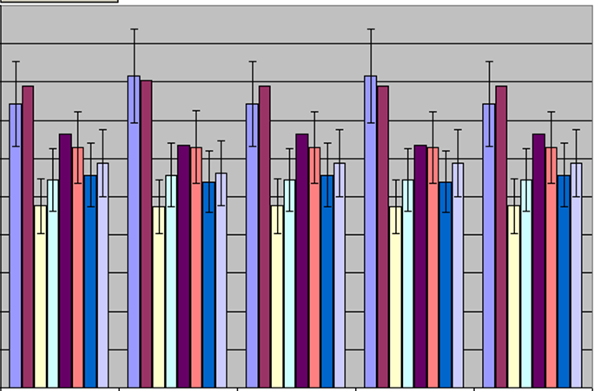
QRS Excel-based Trend Report Value Proposition
    Address trend reporting needs across batches or date/time
        Monitor samples types
          Trend by Samples, CALs, QCs, Blanks, Spikes
        Monitor target compounds or qualifiers results
          Trend metrics grouped by sample/compound/group
          Trend organized by time series { before/after, treated/untreated }
        Monitor outliers results
          Trend by quality metrics
Quantitation Reporting System
Notes:
The deconvolution power of AMDIS increases the quality (no false positives) and confidence level (no false negatives) of the report. Compared with manual manipulation of the data by an experienced analyst (peak averaging and background subtraction of each potential target compound), the time savings using the new software program is about one hour per sample. When DRS searches for 560 target pesticide compounds, the total processing time is one to two minutes per file. Additionally, DRS has the potential to identify more compounds in complex matrices than an analyst would.

Slide 4
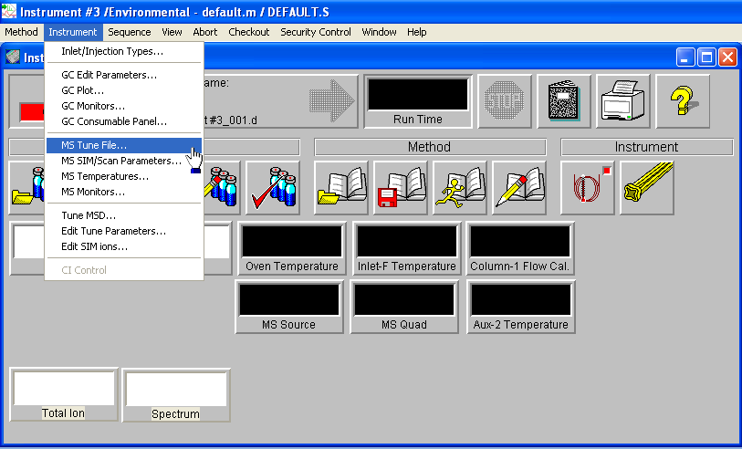
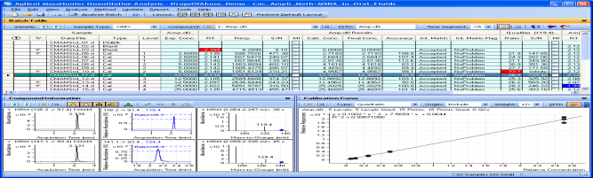
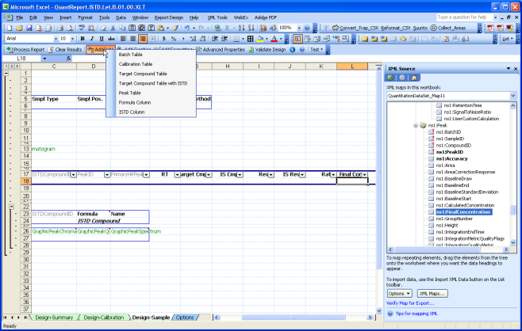
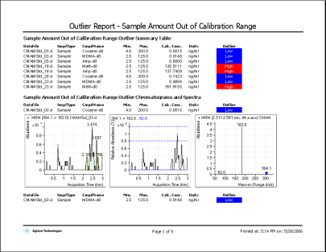
Quantitation Pipeline software architecture
Acquisition
Deliverables:
Acquisition data
Quant
Deliverables:
Reporting results
Roundtripautomation
Deliverables:
Batch based
Excel-based Reports
Reporting
MassHunter Quantitative Analysis

Slide 5
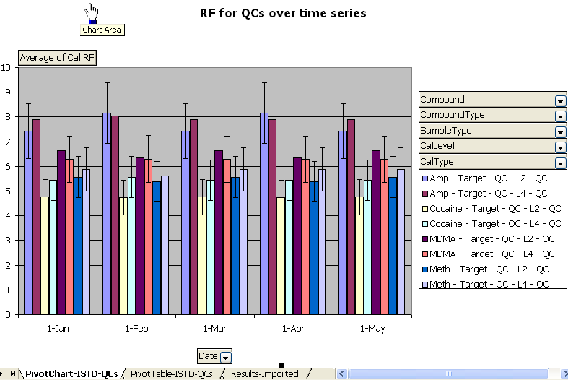
Quantitation Pipeline software architecture
Acquisition
Deliverables:
Acquisition data
Quant
Deliverables:
Reporting results
Roundtripautomation
Reporting
Deliverables:
Batch based
Excel-based Reports
Reporting
Reporting
Reporting
Reporting
Deliverables:
Trend Reporting
Cross-batch
QA trend metrics
MassHunter Quantitative Analysis

Slide 6
Data Warehouse and Analysis Cube (star configuration)
Category
Calibration
BatchName
AcqDate
Level
Time Series
Accuracy
Time
Date
Year
TargetCompound
Analyzed
Amount
(value)
ISTD
Sample
RetentionTime
SampleType
Integration Metric
Instrument
Qualifiers
Outliers
QualifierRatios
Recovery
Quantitation Reporting System

Slide 7
QRS Star Configuration (MultiDimensional Analysis)
Target
Response
Sampling
Time
Compound
Name
Compound
Type
Sample
Name
Batch
Name
Acquisition
DateTime
Sample
Group
Compound
Group
pivot table columns
pivot table rows
Quantitation Reporting System
Notes:
The deconvolution power of AMDIS increases the quality (no false positives) and confidence level (no false negatives) of the report. Compared with manual manipulation of the data by an experienced analyst (peak averaging and background subtraction of each potential target compound), the time savings using the new software program is about one hour per sample. When DRS searches for 560 target pesticide compounds, the total processing time is one to two minutes per file. Additionally, DRS has the potential to identify more compounds in complex matrices than an analyst would.

Slide 8
Excel-based Quantitation Report System (QRS) Trending
Demo
  Extension of MassHunter integrated Excel-based reporting
Notes:
8
There is a portfolio of Agilent GC/MS products:
Start with the 6850GC/5975 VL diffusion pump system. Lowest priced Agilent GC/MS solution. Ideal for dedicated headspace GC/MS applications.
Smallest lab bench footprint.
5975C/7890A is the world’s best selling GC/MS system. Proven performance, superior productivity: Synchronous SIM/SCAN, EI,CI,NCI; capillary flow for backflush and detector splitting; Deconvolution reporting software, new triple axis detector,retention time locking, trace ion detection technology turbomolecular pumping to allow higher GC column flows….
Now the new Agilent 7000A Triple Quad GC/MS Systems. Power of MS/MS to allow quantitation of trace target compounds in complex matrices.
This new system is based on the 5975C architecture.

Slide 9
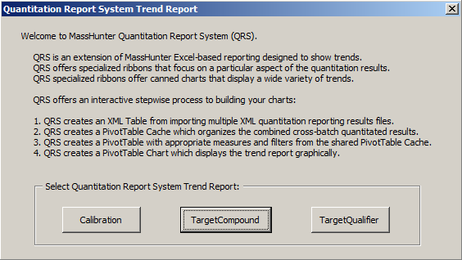
Notes:
9
There is a portfolio of Agilent GC/MS products:
Start with the 6850GC/5975 VL diffusion pump system. Lowest priced Agilent GC/MS solution. Ideal for dedicated headspace GC/MS applications.
Smallest lab bench footprint.
5975C/7890A is the world’s best selling GC/MS system. Proven performance, superior productivity: Synchronous SIM/SCAN, EI,CI,NCI; capillary flow for backflush and detector splitting; Deconvolution reporting software, new triple axis detector,retention time locking, trace ion detection technology turbomolecular pumping to allow higher GC column flows….
Now the new Agilent 7000A Triple Quad GC/MS Systems. Power of MS/MS to allow quantitation of trace target compounds in complex matrices.
This new system is based on the 5975C architecture.

Slide 10
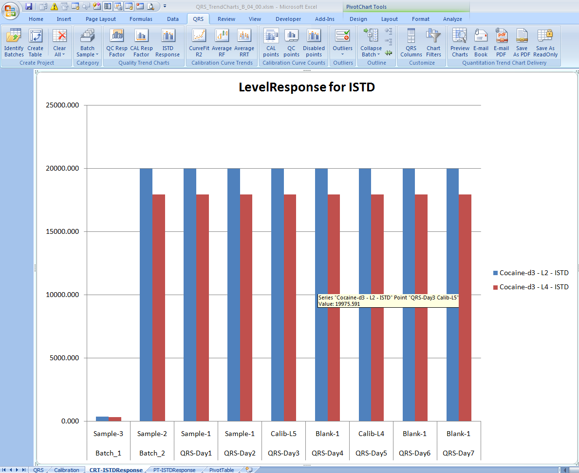
Looking at particular Calibration levels,
are my are my ISTD responses trending?
Notes:
10
There is a portfolio of Agilent GC/MS products:
Start with the 6850GC/5975 VL diffusion pump system. Lowest priced Agilent GC/MS solution. Ideal for dedicated headspace GC/MS applications.
Smallest lab bench footprint.
5975C/7890A is the world’s best selling GC/MS system. Proven performance, superior productivity: Synchronous SIM/SCAN, EI,CI,NCI; capillary flow for backflush and detector splitting; Deconvolution reporting software, new triple axis detector,retention time locking, trace ion detection technology turbomolecular pumping to allow higher GC column flows….
Now the new Agilent 7000A Triple Quad GC/MS Systems. Power of MS/MS to allow quantitation of trace target compounds in complex matrices.
This new system is based on the 5975C architecture.

Slide 11
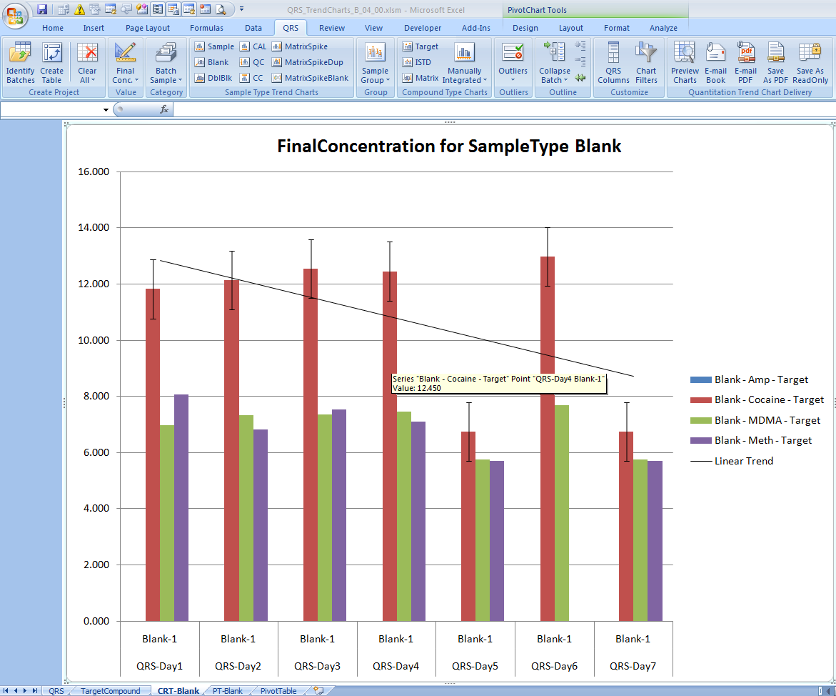
Looking at particular Target Compounds, are my Blank concentrations trending?
Notes:
11
There is a portfolio of Agilent GC/MS products:
Start with the 6850GC/5975 VL diffusion pump system. Lowest priced Agilent GC/MS solution. Ideal for dedicated headspace GC/MS applications.
Smallest lab bench footprint.
5975C/7890A is the world’s best selling GC/MS system. Proven performance, superior productivity: Synchronous SIM/SCAN, EI,CI,NCI; capillary flow for backflush and detector splitting; Deconvolution reporting software, new triple axis detector,retention time locking, trace ion detection technology turbomolecular pumping to allow higher GC column flows….
Now the new Agilent 7000A Triple Quad GC/MS Systems. Power of MS/MS to allow quantitation of trace target compounds in complex matrices.
This new system is based on the 5975C architecture.

Slide 12
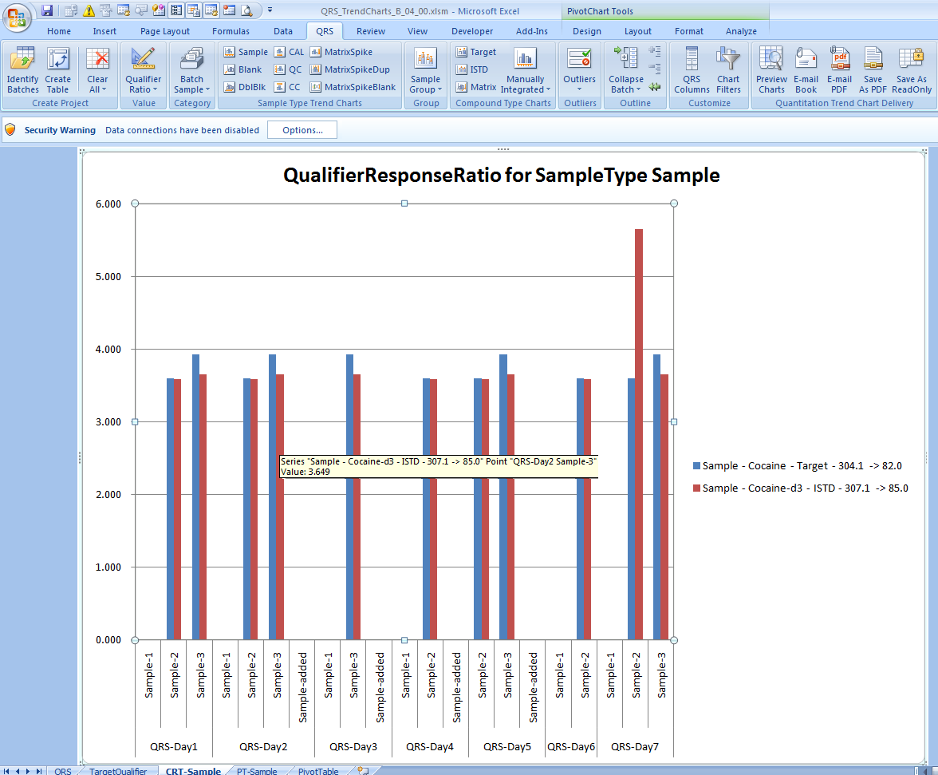
Looking at particular Qualifier transitions,
are my qualifier ratios trending?
Notes:
12
There is a portfolio of Agilent GC/MS products:
Start with the 6850GC/5975 VL diffusion pump system. Lowest priced Agilent GC/MS solution. Ideal for dedicated headspace GC/MS applications.
Smallest lab bench footprint.
5975C/7890A is the world’s best selling GC/MS system. Proven performance, superior productivity: Synchronous SIM/SCAN, EI,CI,NCI; capillary flow for backflush and detector splitting; Deconvolution reporting software, new triple axis detector,retention time locking, trace ion detection technology turbomolecular pumping to allow higher GC column flows….
Now the new Agilent 7000A Triple Quad GC/MS Systems. Power of MS/MS to allow quantitation of trace target compounds in complex matrices.
This new system is based on the 5975C architecture.

Slide 13
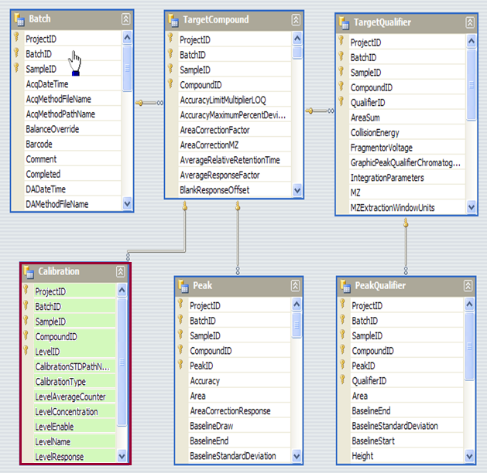
Excel
Table
Pivot Cache
Pivot Table
Pivot Chart
Import
Quant
XML
results
Notes:
13
There is a portfolio of Agilent GC/MS products:
Start with the 6850GC/5975 VL diffusion pump system. Lowest priced Agilent GC/MS solution. Ideal for dedicated headspace GC/MS applications.
Smallest lab bench footprint.
5975C/7890A is the world’s best selling GC/MS system. Proven performance, superior productivity: Synchronous SIM/SCAN, EI,CI,NCI; capillary flow for backflush and detector splitting; Deconvolution reporting software, new triple axis detector,retention time locking, trace ion detection technology turbomolecular pumping to allow higher GC column flows….
Now the new Agilent 7000A Triple Quad GC/MS Systems. Power of MS/MS to allow quantitation of trace target compounds in complex matrices.
This new system is based on the 5975C architecture.

Slide 14
Notes:
14
There is a portfolio of Agilent GC/MS products:
Start with the 6850GC/5975 VL diffusion pump system. Lowest priced Agilent GC/MS solution. Ideal for dedicated headspace GC/MS applications.
Smallest lab bench footprint.
5975C/7890A is the world’s best selling GC/MS system. Proven performance, superior productivity: Synchronous SIM/SCAN, EI,CI,NCI; capillary flow for backflush and detector splitting; Deconvolution reporting software, new triple axis detector,retention time locking, trace ion detection technology turbomolecular pumping to allow higher GC column flows….
Now the new Agilent 7000A Triple Quad GC/MS Systems. Power of MS/MS to allow quantitation of trace target compounds in complex matrices.
This new system is based on the 5975C architecture.

Slide 15
Calibration
trends
Notes:
15
There is a portfolio of Agilent GC/MS products:
Start with the 6850GC/5975 VL diffusion pump system. Lowest priced Agilent GC/MS solution. Ideal for dedicated headspace GC/MS applications.
Smallest lab bench footprint.
5975C/7890A is the world’s best selling GC/MS system. Proven performance, superior productivity: Synchronous SIM/SCAN, EI,CI,NCI; capillary flow for backflush and detector splitting; Deconvolution reporting software, new triple axis detector,retention time locking, trace ion detection technology turbomolecular pumping to allow higher GC column flows….
Now the new Agilent 7000A Triple Quad GC/MS Systems. Power of MS/MS to allow quantitation of trace target compounds in complex matrices.
This new system is based on the 5975C architecture.

Slide 16
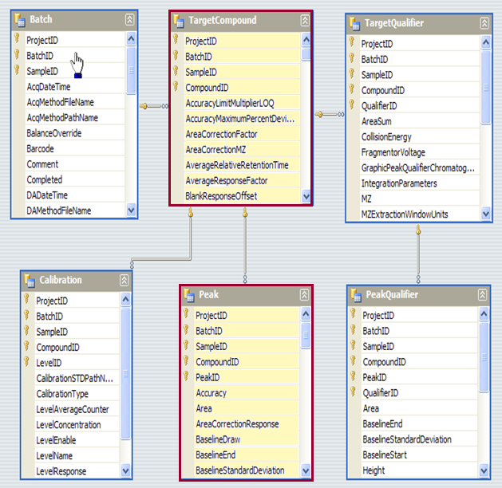
Target Compound
trends
Notes:
16
There is a portfolio of Agilent GC/MS products:
Start with the 6850GC/5975 VL diffusion pump system. Lowest priced Agilent GC/MS solution. Ideal for dedicated headspace GC/MS applications.
Smallest lab bench footprint.
5975C/7890A is the world’s best selling GC/MS system. Proven performance, superior productivity: Synchronous SIM/SCAN, EI,CI,NCI; capillary flow for backflush and detector splitting; Deconvolution reporting software, new triple axis detector,retention time locking, trace ion detection technology turbomolecular pumping to allow higher GC column flows….
Now the new Agilent 7000A Triple Quad GC/MS Systems. Power of MS/MS to allow quantitation of trace target compounds in complex matrices.
This new system is based on the 5975C architecture.

Slide 17
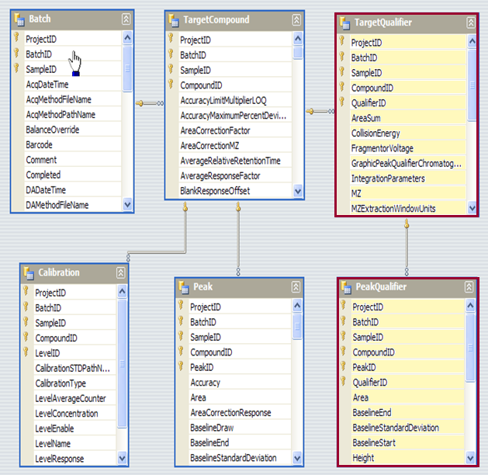
Qualifier
trends
Notes:
17
There is a portfolio of Agilent GC/MS products:
Start with the 6850GC/5975 VL diffusion pump system. Lowest priced Agilent GC/MS solution. Ideal for dedicated headspace GC/MS applications.
Smallest lab bench footprint.
5975C/7890A is the world’s best selling GC/MS system. Proven performance, superior productivity: Synchronous SIM/SCAN, EI,CI,NCI; capillary flow for backflush and detector splitting; Deconvolution reporting software, new triple axis detector,retention time locking, trace ion detection technology turbomolecular pumping to allow higher GC column flows….
Now the new Agilent 7000A Triple Quad GC/MS Systems. Power of MS/MS to allow quantitation of trace target compounds in complex matrices.
This new system is based on the 5975C architecture.

Slide 18
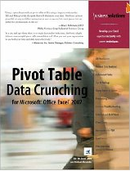
Pivot Table Data Crunching for Microsoft Office Excel 2007 consolidates all the best functionality of pivot tables including Using VBA to Create Pivot Tables
Notes:
18
There is a portfolio of Agilent GC/MS products:
Start with the 6850GC/5975 VL diffusion pump system. Lowest priced Agilent GC/MS solution. Ideal for dedicated headspace GC/MS applications.
Smallest lab bench footprint.
5975C/7890A is the world’s best selling GC/MS system. Proven performance, superior productivity: Synchronous SIM/SCAN, EI,CI,NCI; capillary flow for backflush and detector splitting; Deconvolution reporting software, new triple axis detector,retention time locking, trace ion detection technology turbomolecular pumping to allow higher GC column flows….
Now the new Agilent 7000A Triple Quad GC/MS Systems. Power of MS/MS to allow quantitation of trace target compounds in complex matrices.
This new system is based on the 5975C architecture.

Slide 19
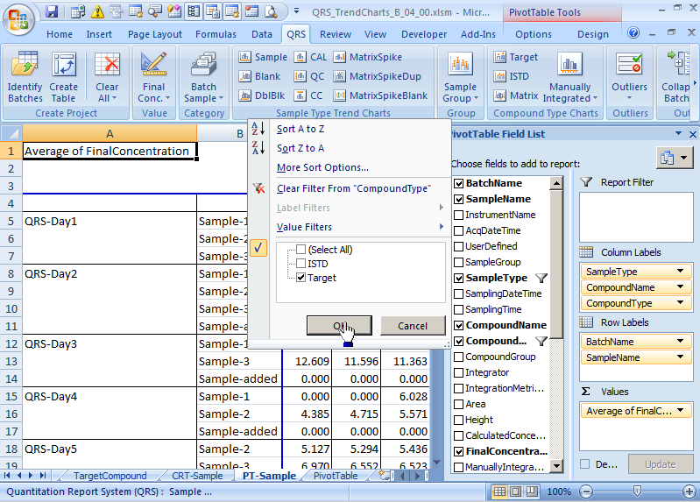
Pivot Chart (CRT-)
Pivot Table (PT-)
Pivot Table (PivotTable)
Notes:
19
There is a portfolio of Agilent GC/MS products:
Start with the 6850GC/5975 VL diffusion pump system. Lowest priced Agilent GC/MS solution. Ideal for dedicated headspace GC/MS applications.
Smallest lab bench footprint.
5975C/7890A is the world’s best selling GC/MS system. Proven performance, superior productivity: Synchronous SIM/SCAN, EI,CI,NCI; capillary flow for backflush and detector splitting; Deconvolution reporting software, new triple axis detector,retention time locking, trace ion detection technology turbomolecular pumping to allow higher GC column flows….
Now the new Agilent 7000A Triple Quad GC/MS Systems. Power of MS/MS to allow quantitation of trace target compounds in complex matrices.
This new system is based on the 5975C architecture.

Slide 20
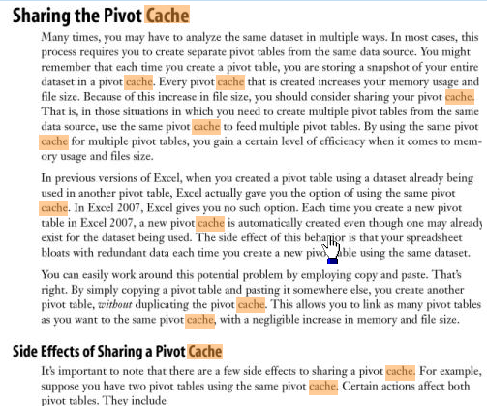
Pivot Cache shared by Pivot Tables. Different Pivot Caches created for
Calibration
TargetCompound
Qualifier
Notes:
20
There is a portfolio of Agilent GC/MS products:
Start with the 6850GC/5975 VL diffusion pump system. Lowest priced Agilent GC/MS solution. Ideal for dedicated headspace GC/MS applications.
Smallest lab bench footprint.
5975C/7890A is the world’s best selling GC/MS system. Proven performance, superior productivity: Synchronous SIM/SCAN, EI,CI,NCI; capillary flow for backflush and detector splitting; Deconvolution reporting software, new triple axis detector,retention time locking, trace ion detection technology turbomolecular pumping to allow higher GC column flows….
Now the new Agilent 7000A Triple Quad GC/MS Systems. Power of MS/MS to allow quantitation of trace target compounds in complex matrices.
This new system is based on the 5975C architecture.

Slide 21
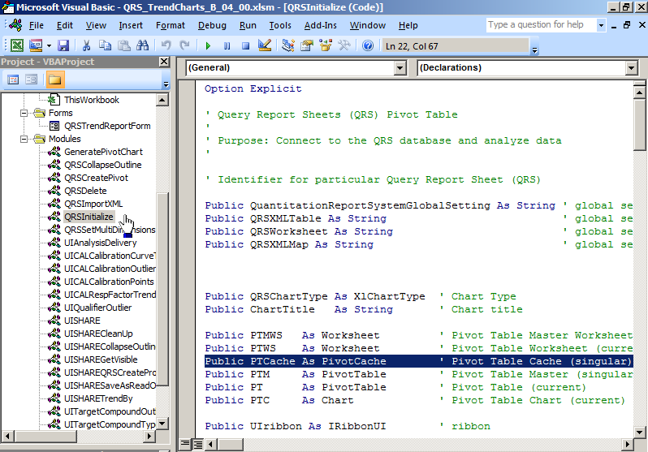
Pivot Cache declaration
Notes:
21
There is a portfolio of Agilent GC/MS products:
Start with the 6850GC/5975 VL diffusion pump system. Lowest priced Agilent GC/MS solution. Ideal for dedicated headspace GC/MS applications.
Smallest lab bench footprint.
5975C/7890A is the world’s best selling GC/MS system. Proven performance, superior productivity: Synchronous SIM/SCAN, EI,CI,NCI; capillary flow for backflush and detector splitting; Deconvolution reporting software, new triple axis detector,retention time locking, trace ion detection technology turbomolecular pumping to allow higher GC column flows….
Now the new Agilent 7000A Triple Quad GC/MS Systems. Power of MS/MS to allow quantitation of trace target compounds in complex matrices.
This new system is based on the 5975C architecture.

Slide 22
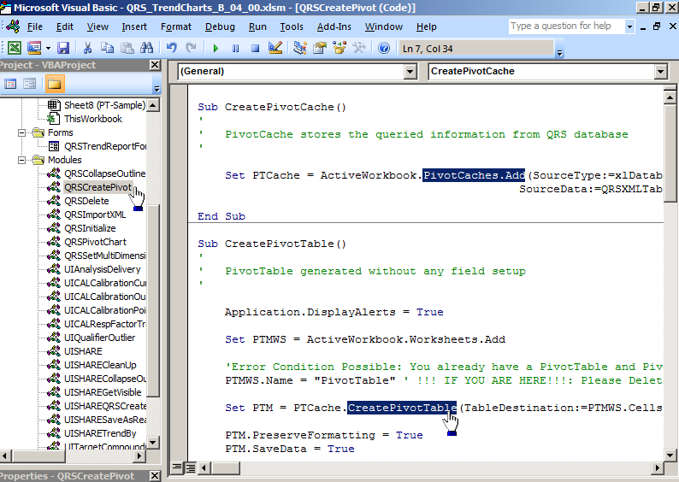
Pivot Cache creation
Pivot Table creation
Notes:
22
There is a portfolio of Agilent GC/MS products:
Start with the 6850GC/5975 VL diffusion pump system. Lowest priced Agilent GC/MS solution. Ideal for dedicated headspace GC/MS applications.
Smallest lab bench footprint.
5975C/7890A is the world’s best selling GC/MS system. Proven performance, superior productivity: Synchronous SIM/SCAN, EI,CI,NCI; capillary flow for backflush and detector splitting; Deconvolution reporting software, new triple axis detector,retention time locking, trace ion detection technology turbomolecular pumping to allow higher GC column flows….
Now the new Agilent 7000A Triple Quad GC/MS Systems. Power of MS/MS to allow quantitation of trace target compounds in complex matrices.
This new system is based on the 5975C architecture.

